Slide 1

Information Systems in Organizations
Pertemuan 2
Dr. Dedi Trisnawarman

Slide 2
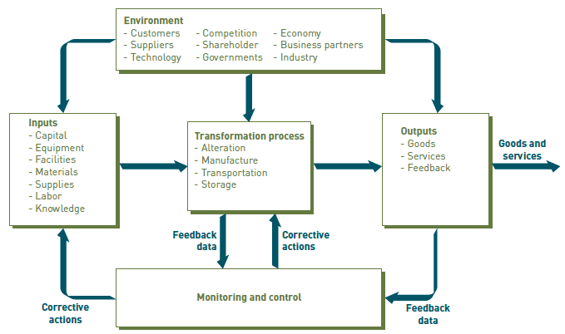
General Model of An Organization
organization: A group of people that is structured and managed to meet its mission or set of group goals.

Slide 3
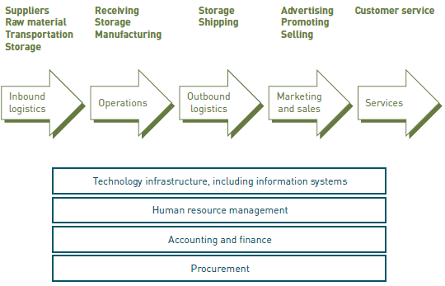
Value Chain & Supply Chain :
Value Chain: A series (chain) of activities that an organization performs to transform inputs into outputs in such a way that the value of the input is increased.
supply chain: A key value chain whose primary activities include inbound logistics, operations, outbound logistics, marketing and sales, and service.

Slide 4
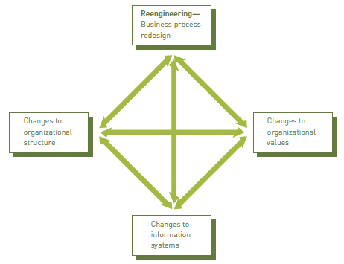
Business Process Reengineering, BPR):
The radical redesign of business processes, organizational structures, information systems, and values of the organization to achieve a breakthrough in business results.
Reengineering involves the radical redesign of business processes, organizational structure, information systems, and the values of an organization to achieve a breakthrough in business results.

Slide 5
